Slide 1
Digital Portfolio
STUDENT NAME: M. PREETHIYA
REGISTER NO AND NMID: asunm1729212406035
DEPARTMENT: BACHELOR OF COMPUTER APPLICATION
COLLEGE: PRINCE SHRI BALAJI ARTS AND SCIENCE COLLEGE/
UNIVERSITY OF MADRAS

Slide 2
PROJECT TITLE
Codefolio

Slide 3


AGENDA
Problem Statement
Project Overview
End Users
Tools and Technologies
Portfolio design and Layout
Features and Functionality
Results and Screenshots
Conclusion
Github Link
3/21/2024 Annual Review

Slide 4

PROBLEM STATEMENT
Many developers face challenges presenting their skills and projects effectively.
Static resumes lack interactivity and fail to showcase technical skills visually.
Existing portfolio templates are often generic and uninspired.
👉 The industry demands a creative, interactive, and modern solution that highlights coding ability, creativity, and personality.

Slide 5

PROJECT OVERVIEW
A modern, dynamic, and fully responsive digital portfolio. Purpose-built for developers who want to stand out and leave a lasting impression.
Focused on interactivity, clean design, and easy customization.
🌟 Showcases personal projects, skills, client testimonials, and offers direct contact.

Slide 6

WHO ARE THE END USERS?
👨‍💻 Job-seeking developers 🌍 Freelance web developers showcasing their portfolio 🎓 Tech students building their first professional presence 🎨 Designers with coding skills ✔️ Perfect for anyone wanting a personal, creative, and professional online presence.

Slide 7

TOOLS AND TECHNIQUES
💻 Built Using Modern Web Standards ✅ HTML – Structure of the website ✅ CSS – Styling with a modern dark theme ✅ JavaScript – Dynamic rendering of projects and form behavior ✅ GitHub – Version control and portfolio hosting ✅ Responsive Design – Works seamlessly on desktop, tablet, and mobile ✨ Lightweight, fast-loading, and easy to customize

Slide 8
POTFOLIO DESIGN AND LAYOUT
🌈 Key Design Concepts Dark mode theme for a sleek modern aesthetic Clean navigation bar for intuitive user experience Visually engaging project grid with interactive hover animations Well-defined sections: ▫ About Me → Introduces the developer ▫ Skills → Displays key technical strengths ▫ Projects → Interactive showcase of work ▫ Testimonials → Builds social proof ▫ Contact → Easy direct messaging form 📱 Mobile-first design guarantees usability across all devices.
8

Slide 9
FEATURES AND FUNCTIONALITY
⚡ Innovative Functionalities ✔️ Dynamic project cards generated by JavaScript ✔️ Smooth hover animations for user interaction ✔️ Interactive contact form with instant feedback ✔️ Seamless scrolling for easy navigation ✔️ Fully responsive using CSS Grid Layout ✔️ Testimonials section offering trusted feedback 💡 Minimal design focused on impactful content delivery

Slide 10
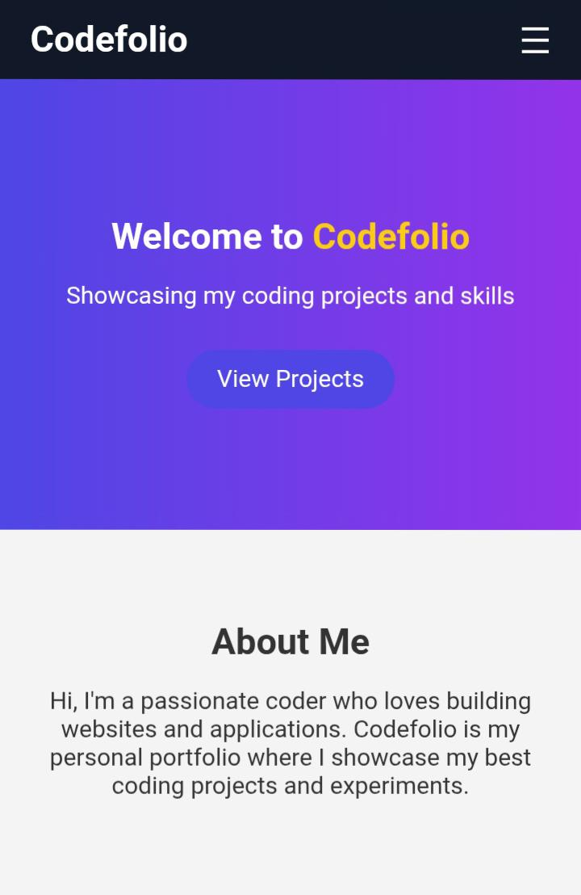

RESULTS AND SCREENSHOTS
3/21/2024 Annual Review
10

Slide 11
CONCLUSION
✨ Why Codefolio Is Special ✔️ A sleek, modern solution to showcase developer skills ✔️ Highlights projects and makes client interaction easy ✔️ Easy to customize and scalable for future improvements ✔️ Built with future-proof web technologies 🚀 The perfect launchpad for your personal brand in the tech world 🌟 This version now reads like a professional, creative pitch deck that inspires confidence while keeping your content intact. 👉 Would you like me to create a downloadable PowerPoint (.pptx) file based on this structure next?
11

